Slide 1
‘Thinking Collectively about Environmental awareness, urban sustainability and abatement of climate change risks:
can we as scholars, train young minds in India?’

Slide 2
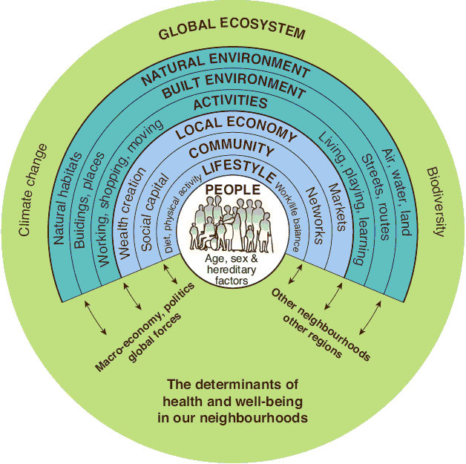
ENVIRONMENTAL AWARENESS
Environmental awareness is important because it has positive effects on environmental health, sustainable development and reducing global warming.
Environmental health refers to aspects of human health (including quality of life) that are determined by physical, biological and social factors in the environment.
The UN includes fighting poverty, hunger, lack of water and food as essential sustainable development goals.
Global warming is the long-term heating of Earth's climate system due to human activities which increases greenhouse gas levels in Earth's atmosphere.

Slide 3
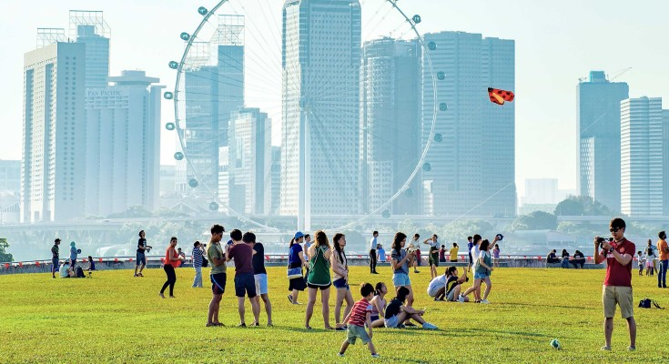
URBAN SUSTAINABILITY
…
The idea that a city can be improved and built upon, without the active utilisation of resources, without an excessive reliance on external areas like the countryside, all the while powering itself with renewable sources of energy.
…
That is, to create the smallest possible ecological footprint, to reduce pollution as far as possible, to optimise land use, to manage and utilise used materials and to minimise the city’s contribution to climate change.
Given that approximately 50% of the world population resides in urban areas, urban sustainability becomes the crucial investment that humans need to make.
The scope of urban sustainability is very broad; it spans air quality, water quality, ecological footprints, financial health, infrastructure, education and community health and urban sustainability itself is hard to quantify. Therefore, it becomes important for us to have a clear understanding of it, and to take steps to attain urban sustainability in order to tackle climate change.

Slide 4

CLIMATE CHANGE
Climate change refers to long-term shifts in temperatures and weather patterns. These shifts may be natural, such as through variations in the solar cycle. But since the 1800s, human activities have been the main driver of climate change, primarily due to burning fossil fuels and has lead to global warming.
Some of the harmful effects of climate change as listed by the United Nations are Hotter temperatures, More severe storms, floods, Increased drought, warming and rising ocean, Loss of species, Not enough food, More health risks, Poverty and displacement.

Slide 5
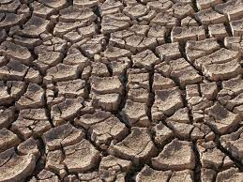
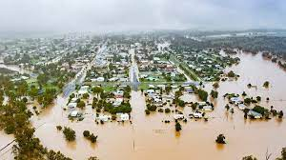
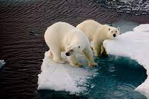
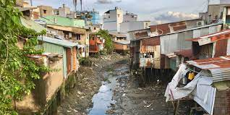
Effects of Climate Change

Slide 6
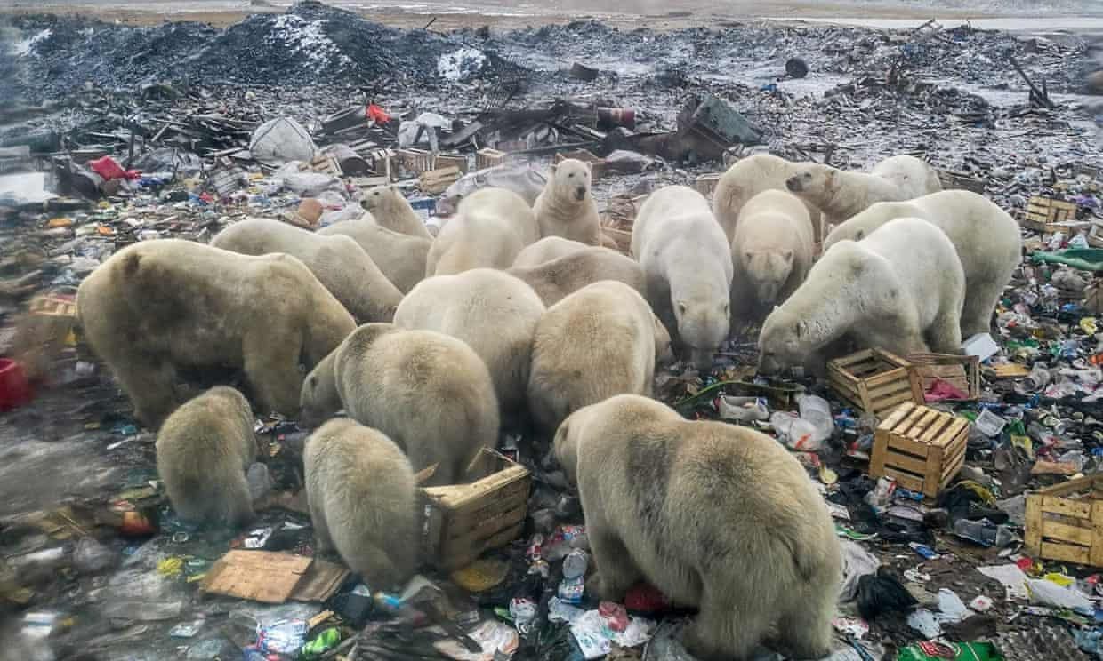
The destruction of Arctic ecosystems forces animals to search for food on land, such as these polar bears in northern Russia.

Slide 7
URBAN UNSUSTAINABILITY - ENVIRONMENT - CLIMATE CHANGE
Cities can become places of social and economic mobility, they can also become cores of inequality and environmental degradation. Global poverty caused by inequitable economic development has impacted human health.
Urban unsustainability is a community-level concern; it cannot be addressed individually and leads to environmental degradation and climate change.
Phenomena including global warming, destruction of the ozone shield, acidification of land and water, extinction of species and etc demonstrate that human demand is exceeding environmental support capacities.
We are meeting these challenges today, as a climate change doomsday scenario – an outcome of unsustainable urban and rural development.
Consequences of unsustainable practices will fall on economies. Biodiversity loss is already leading to wars, political destabilisation, and international tension.
Unsustainable practices like significant population increases, migration, and accelerated socio-economic and industrial activities lead to climate change which causes extreme weather events like droughts, floods, and wind storms which have brought economic downturns in many nations of the world.

Slide 8
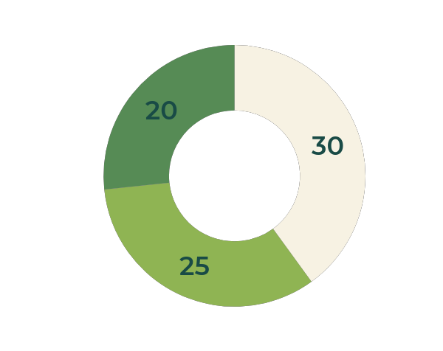
Why to train the young minds?
Almost half of humanity resides in the cities and almost 4 out of 10 people on Earth, are under 25.
“We have not inherited this Earth from our forefathers; we have borrowed it from our children”
-Dr. Lester Brown

Slide 9
How can we train the youth?
The primary step toward achieving a successful sustainability development is to create awareness which can be done through diverse initiatives like educational, awareness-raising and behavioural change campaigns.
The education provided by parents that begins at home is informal education on the practice of sustainability.
Environmental education needs to be taught as early as preschool. Early childhood education is an important step towards educating the youth to become more aware of environmental sustainability. It strengthen environmental awareness, ensure healthy lifestyles, and promote a sense of responsibility.
Recycling is a simple, yet effective way of conserving resources and reducing your individual carbon footprint and generates a circular economy.
Along with this we have to be mindful of the amount of resources we spend like water, fossil fuel resources.
Invest in research on renewable sources of energy so that more youth will take up such fields and their knowledge can be used for the betterment.
Youth also engage in climate change projects within different national and international organizations.

Slide 10
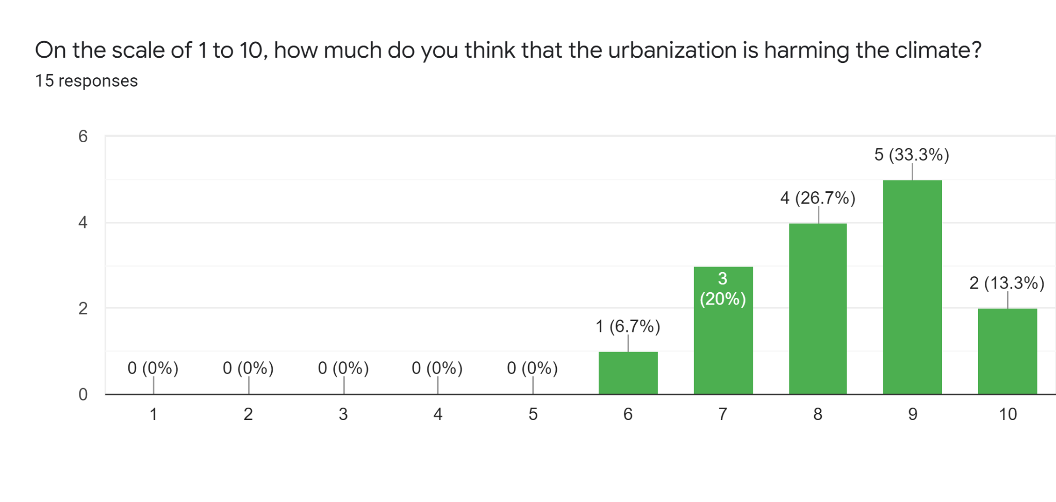
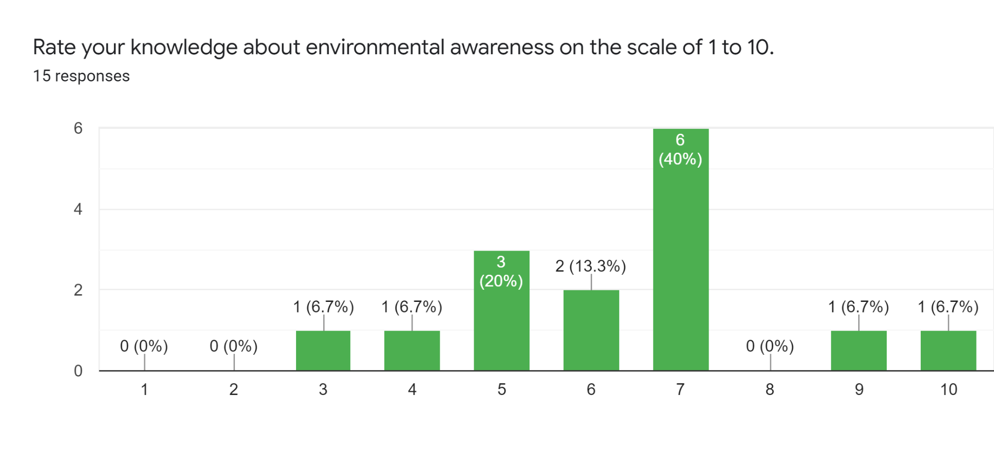
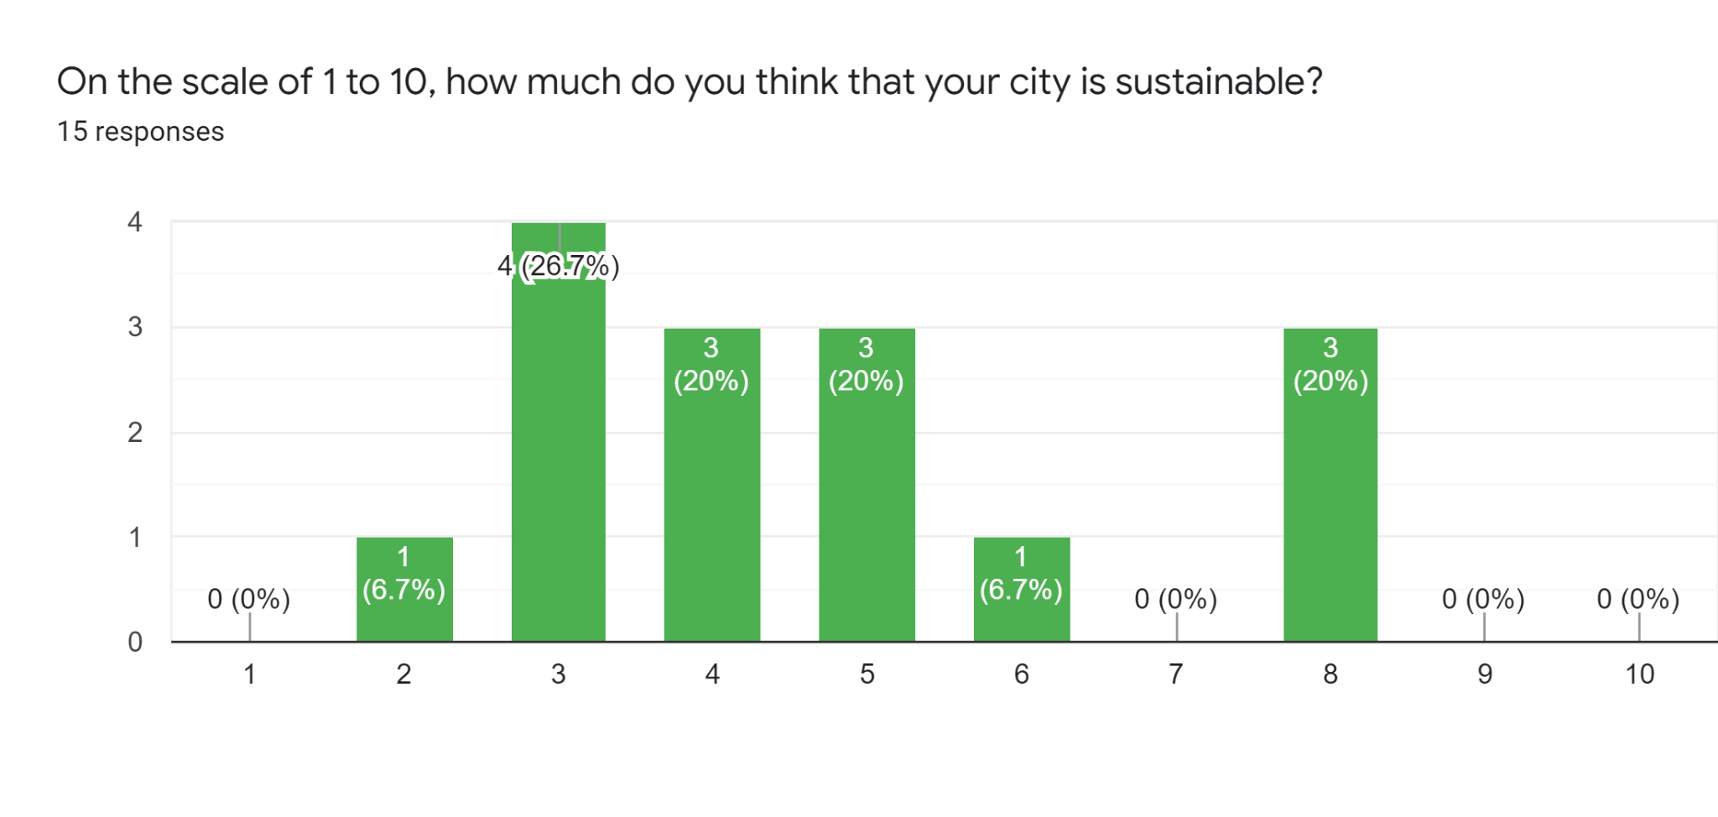
POLL RESULTS

Slide 11
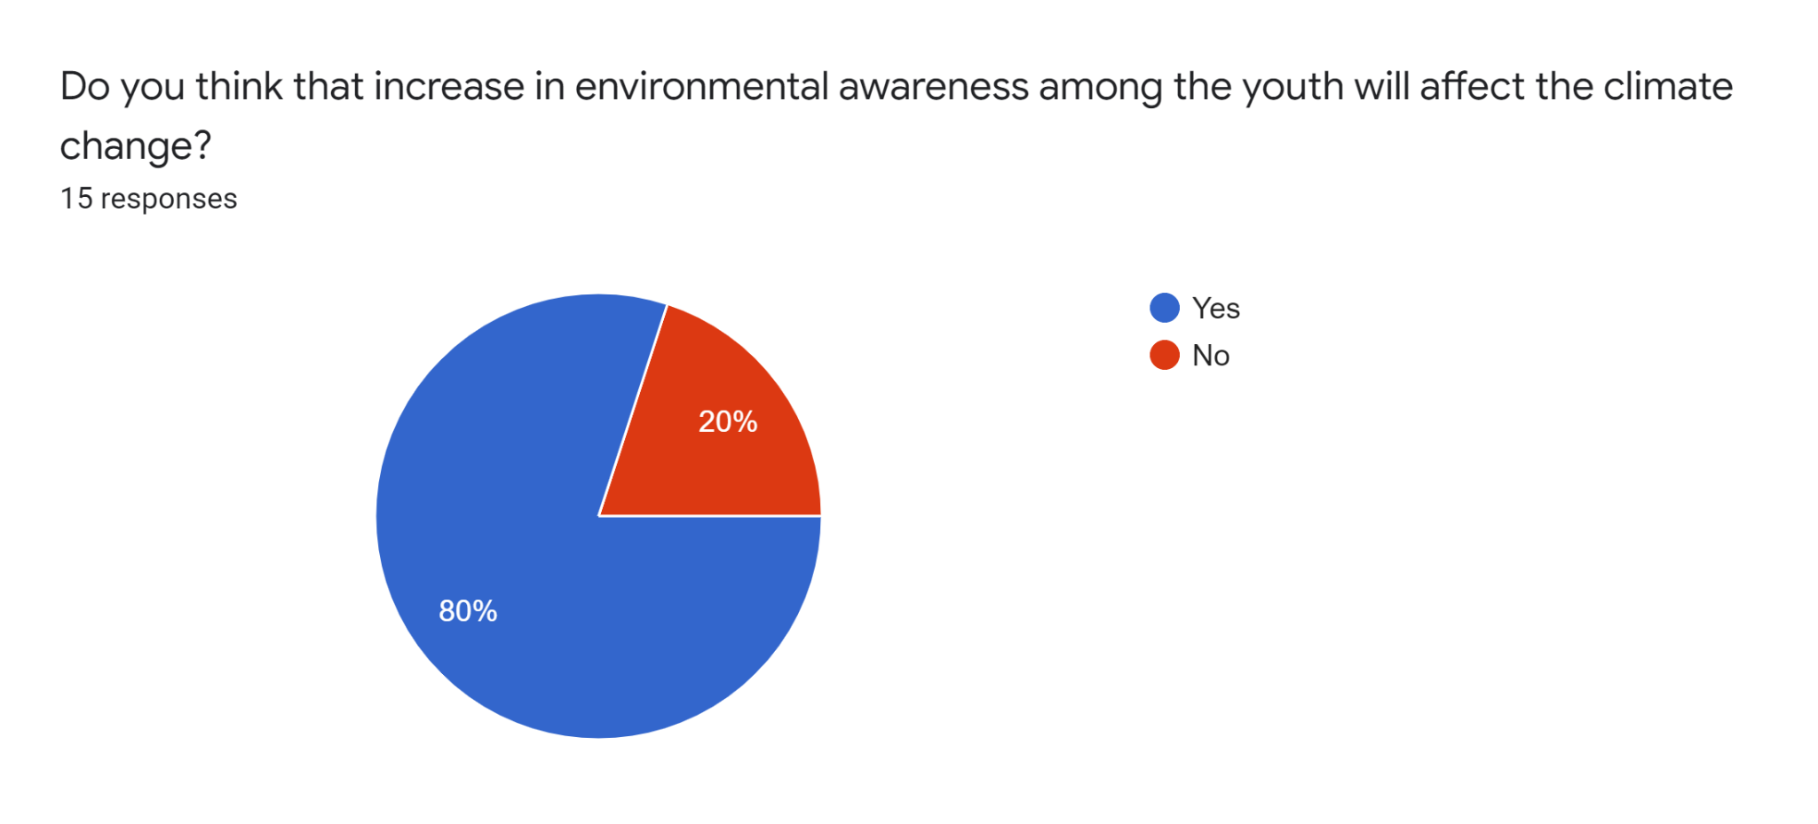
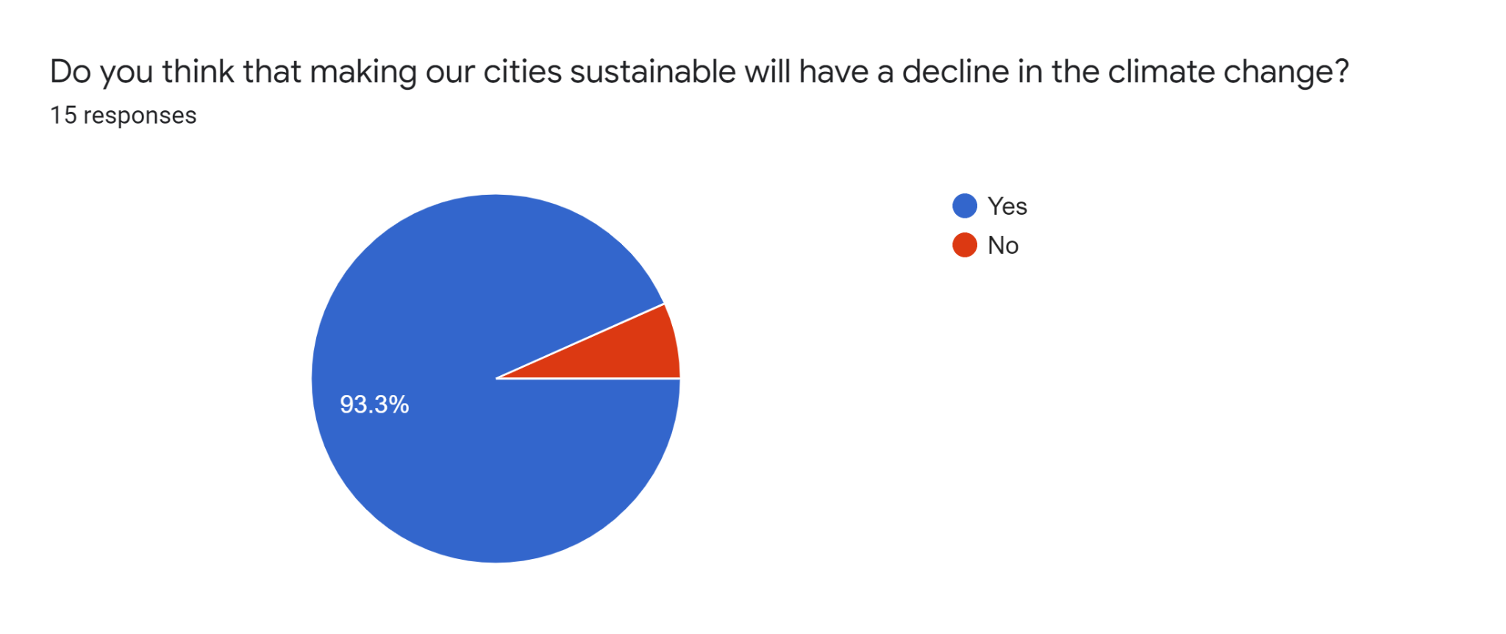
Majority of the people think that environmental awareness can reduce climate changes
Majority of the people think that creating sustainable cities will reduce climate changes and its effects

Slide 12
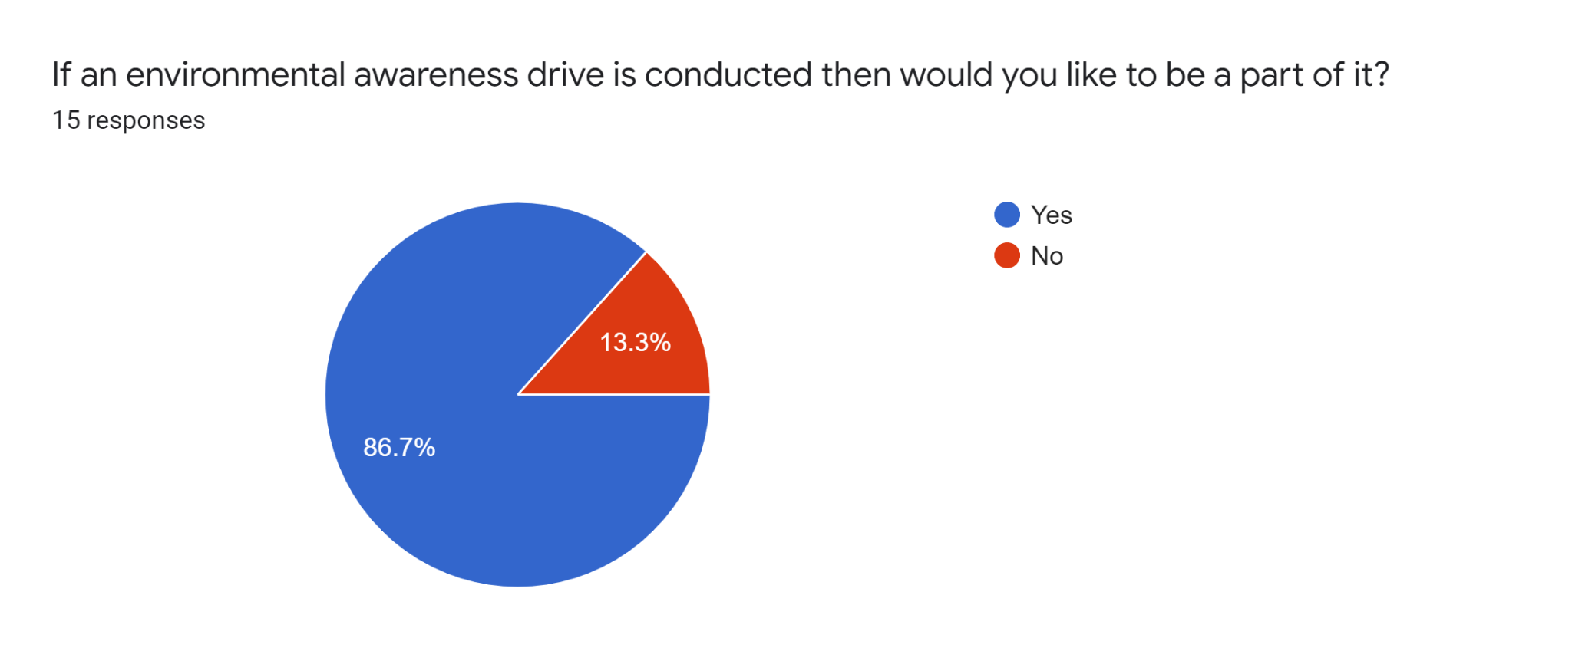
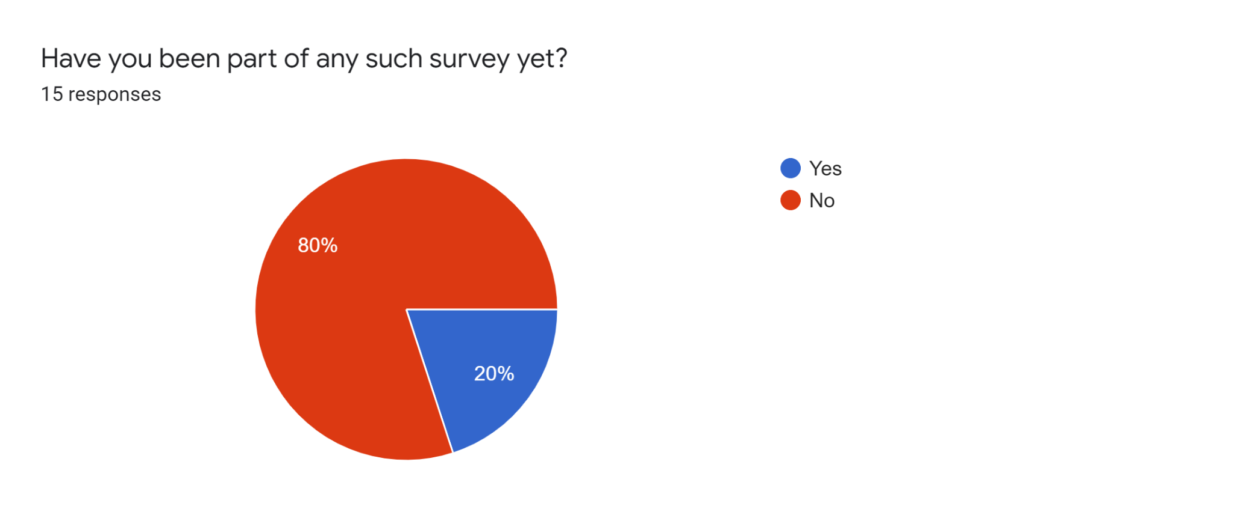
More people want to be a part of environmental awareness programmes which shows the enthusiasm of youth towards environmental conservation.
Majority of the people have not taken such surveys before, which shows there is a gap between vision and implementation of awareness drives.

Slide 13
Youth Dialogue Project, Brasil
In the early 2000s, debates on youth issues in Brazil intensified and new institutional frameworks emerged. Since then, there has been significant progress in acknowledging adolescent and youth rights and this mobilisation gained power with the national response to the “Young Wave”, when the proportion of adolescents and youth reached one-quarter of the Brazilian population
In Brazil, from 2004 to 2006, a Youth Dialogue Project was used to generate ideas for educational reforms. Those ideas were subsequently put into practice by several states.
At the state and local levels, these movements culminated in the creation of youth secretariats, sub-secretariats, coordinating committees, boards of directors and councils that currently operate in around a thousand municipalities and 25 states and are responsible for youth policies and social control.
Such a framework could be employed in a country like ours, which is home to a fifth of the world’s youth demographic.

Slide 14


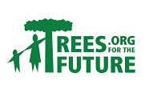
Forest App, Ecosia
Forest is an app that helps you stay focused especially aimed at students.
Forest team partners with a real-tree-planting organization, Trees for the Future, to plant real trees on Earth. When our users spend virtual coins they earn in Forest on planting real trees, Forest team donates to our partner and creates planting orders.
So far the organisation has planted 13,19,578 real trees in select African countries, where the climatic and economic challenges were most pressing.
There are also other websites like Ecosia, a search engine, that plant trees using revenue from user searches.

Slide 15
CONCLUSION
We surfed through Environmental awareness, urban sustainability, climate changes and its effects.
We also saw how these three are not different entities but are deeply interconnected and affect each other.
Poor unsustainable planning of cities has lead to various environmental effects and has also increased the economic burden on the society.
We saw why Young india needs more awareness about these issues and how they can be roped in to lead a sustainable lifestyle.
We also saw some interesting examples that encourages youth towards conservation of nature and sustainability.

Slide 16
THANK YOU

